Slide 1
Last Weeks Objectives
Understand the Basics of L-Systems: Learn the foundational concepts, including their structure (alphabet, axiom, production rules), origin, and significance in modeling growth processes.
Explore Applications of L-Systems: Discover how L-systems are applied in computer graphics, such as modeling plants, creating fractals, generating terrains, and simulating natural phenomena.
Learn to Implement L-Systems: Gain practical skills to design and visualize L-systems using algorithms, including implementation in Unity with tools like turtle graphics and 3D modeling.
Encourage Experimentation and Creativity: Experiment with different axioms, rules, and dimensions to create unique fractals and realistic models, while enhancing adaptability and customization through scripting.

Slide 2

Distribution Methods in Video Games
Understanding Procedural Placement of Items

Slide 3
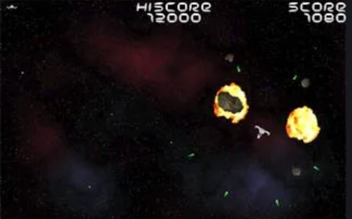
How would you distribute items?
You are tasked with creating a space asteroids game.
The client wants pickups to give, score, lives and weapon upgrades.
What algorithmic methods would you employ to place items in random areas of the screen?
Work in groups to develop an algorithm, We will discuss the result.
Set Camera background to black, kick it into 2D mode and place white spheres and showcase your algorithm. You have 15 mins.

Slide 4
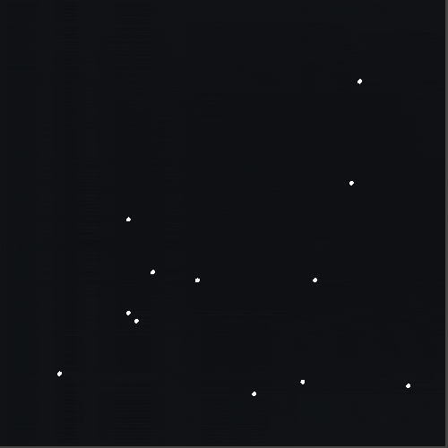
Random Distribution
Imagine a 100x100 play area where 500 objects are placed randomly. This method can cause clusters of objects in some areas and voids in others.
Notes:
Uniform Random Sampling
How it works: Simply pick random points within a given range, with no constraints on their spacing.
Complexity: Very simple and often the easiest to implement.
Advantages:
Minimal computational overhead.
Fast, with no rejection checks or neighbor relationships to maintain.
Disadvantages:
Results in clumping and uneven spacing.
May not meet visual or application-specific requirements (e.g., in procedural generation or rendering).
Verdict: Uniform random sampling is easier than Poisson-disc sampling but lacks the uniform spacing benefits.

Slide 5
Random Distribution
Randomly distributing objects is the simplest method but often leads to uneven placement with over-sampled and under-sampled areas.

Slide 6
Todays Learning Objectives:
Understand Random and Uniform Object Distribution Techniques
Comprehend the differences between random distribution and methods like Poisson disc sampling in creating evenly spaced placements.
Explore and Implement Mitchell's Best-Candidate Algorithm
Learn the steps and logic behind this algorithm to achieve uniform distributions and avoid clustering.
Evaluate the Performance of Distribution Methods
Compare algorithms like Mitchell's Best-Candidate and Bridson’s Algorithm to understand their efficiency, strengths, and limitations in video game applications.
Apply Knowledge in Practical Game Development Tasks
Use learned distribution techniques to implement item placement strategies in a simulated environment, such as a space game scenario, while addressing computational considerations.

Slide 7
Introducing Poisson Disc Sampling
Poisson disc sampling generates points such that each point is at least a minimum distance from any other point, ensuring that each point is distributed in a way that is both random and uniform.
Useful in computer graphics, procedural generation, and simulations where a natural-looking distribution of points is needed, such as in texture generation, placing trees in a forest, or distributing particles in a simulation
Key Concepts:
Uniform Distribution: Points should be evenly spread out over the space. This means that no region should be too dense or too sparse.
Minimum Distance: There is a fixed minimum distance between any two points. This ensures that the points are not too close to each other, preventing clustering.
Randomness: Despite the uniformity, the placement of points is random, so no regular grid patterns are formed

Slide 8
Poisson-Disc Sampling has many algorithms
Summary of Algorithm Types:
Type | Ease of Implementation | Efficiency | Uniformity | Common Use Cases
Dart-Throwing | Easy | Low | Medium | Basic introductions, small-scale sampling
Bridson’s Algorithm | Moderate | High | High | Graphics, procedural generation
Recursive Subdivision | Moderate | Medium | Medium | Adaptive sampling, multiscale generation
Tile-Based Methods | Moderate | Very High | Medium | Large-scale seamless pattern generation
Lloyd’s Relaxation | Hard | Medium | Very High | Mesh generation, remeshing, adaptive densities
Energy-Based Methods | Hard | Low | High | Simulations, specialized uniform distributions
Blue Noise Sampling | Very Hard | Medium | Very High | Graphics, texture generation, rendering
Clustered Poisson-Disc | Hard | Medium | Medium | Biological/physical simulations
Randomized Spatial Partitioning | Moderate | Medium | Medium | Non-uniform or adaptive densities
To Fit them all in this session would break us all, lets focus on top picks

Slide 9
Comparison of the Three Algorithms
Algorithm | Ease of Understanding | Efficiency | Point Distribution Quality
Dart Throwing | Very simple to grasp | Inefficient for dense packing | Moderate, prone to clustering
Mitchell's Algorithm | Moderate complexity | Moderately efficient | High-quality, evenly spaced
Bridson's Algorithm | Slightly more advanced | Highly efficient | Excellent, true Poisson-disc

Slide 10
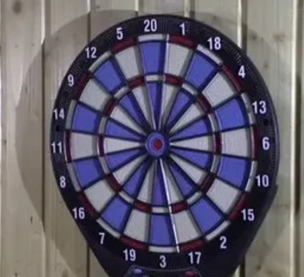
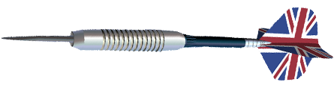
Lets start with the easiest Dart throwing
Randomly "throw darts" (place points) into the domain.
Each dart has a distance constraint area around it
More darts are constantly thrown in
If it lands within another darts constraints, discard it
Repeat until the desired number of points is generated or no valid positions remain.
Task: As a whole group why plan how you will code this using PseudoCode, Your welcome to use Board

Slide 11
Dart-Throwing Natural Language Pseudocode
Initialize an empty list to store generated points.
Set a maximum number of attempts to try generating points.
Repeat until the number of attempts is exceeded:
Randomly generate a new point within the defined area.
Check if this point is at least the minimum distance away from all existing points:
If valid, add it to the list of points.
If not, increment the attempt counter.
Stop when the maximum number of attempts is reached.
Return the list of points.
Shall we code this now?
Notes:
Key Features:
Evaluates a fixed number of candidates per iteration.
Uses a scoring mechanism (minimum distance) to ensure even spacing.
Prioritizes points that enhance the uniformity of the distribution.
Efficiency:
More computationally intensive than basic dart throwing due to evaluation of multiple candidates.
Results in better spatial uniformity and less clumping compared to simple dart throwing.

Slide 12
What happens as we generate more points?
Valid points become harder to find.
Clustering or unevenness can occur in the random selection process.
How can we improve the evenness of the point distribution without sacrificing too much performance?

Slide 13
Key Idea
Dart Throwing chooses one random point at a time, but Mitchell's generates several candidates and selects the one that is farthest from all existing points.
By doing this, Mitchell's algorithm optimizes the placement of each new point, resulting in a more evenly spaced distribution.

Slide 14

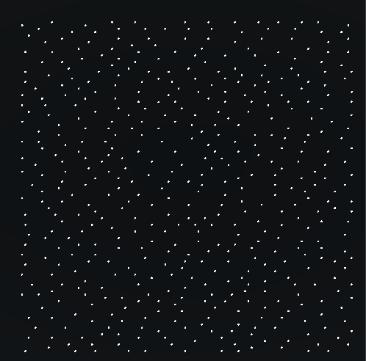
Mitchells Poisson Disc Sampling
Points are distributed more evenly, with no clusters or voids, simulating more natural placements like trees in a forest.

Slide 15
Simplified Steps of Mitchell's Algorithm
Start with an empty list of points.
Repeat until enough points are generated
For each candidate:
Measure its distance to the nearest existing point.
Choose the candidate that is farthest away from all existing points.
Add this "best candidate" to the list.
Generate N random candidate points (e.g., 10 candidates).
Notes:
Vector2 bestCandidate = Vector2.zero; float bestDistance = 0; for (int i = 0; i < numCandidates; i++) { // Generate a random candidate Vector2 candidate = new Vector2( Random.Range(0f, 10f), Random.Range(0f, 10f) ); // Find the distance to the nearest point in the list float nearestDistance = float.MaxValue; foreach (Vector2 point in points) { float distance = Vector2.Distance(candidate, point); nearestDistance = Mathf.Min(nearestDistance, distance); } // Update the best candidate if this one is farther if (nearestDistance > bestDistance) { bestCandidate = candidate; bestDistance = nearestDistance; } } // Add the best candidate to the points list points.Add(bestCandidate); }

Slide 16
Steps of the Algorithm:
Initialization:
Decide on the number of points NNN that you want to generate, the minDistance and candidates buffer.
Initialize an empty set of vector 2 named points.
Generate Points:
Start by creating bestCandidate vector and set it a default value in case it’s the first.
For each number of candidate :
Generate Candidates:
Generate a random candidate points.
Evaluate Candidates:
For each candidate, calculate its distance to the nearest point in the existing set of points.
Select the Best Candidate:
Choose the candidate that has the maximum distance from its nearest neighbor (i.e., the "best" candidate in terms of maximizing the distance to the closest existing point).
Add the Best Candidate to the Set:
Add this best candidate to the set of points.
Repeat:
Repeat the above process until all NNN points have been placed.

Slide 17
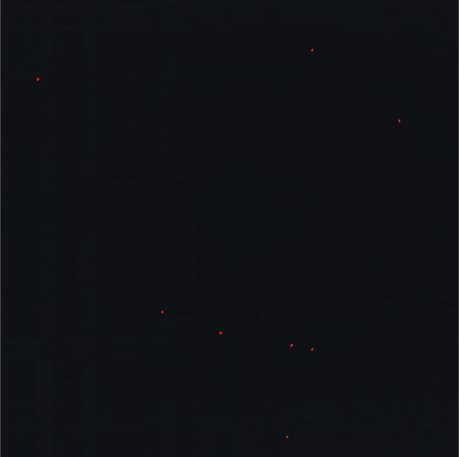
Task: Implement Poisson Disc Sampling
Follow the steps to implement Poisson disc sampling in Unity, ensuring each object is placed at a minimum distance from others.

Slide 18
Issues with this method
Mitchell’s placing algorithm is designed to create a distribution of points where each new point is as far away as possible from all existing points. This algorithm ensures that the points are spread out evenly, but this process can be computationally expensive and slow due to several reasons:
Distance Calculations:
For each candidate point, the algorithm calculates the distance to all existing valid points. Distance calculations involve mathematical operations that need to be performed multiple times.
As the number of valid points increases, the number of distance calculations grows. For example, with 500 points, each new candidate requires checking against all previous points, leading to a lot of repeated calculations.
Nested Loops:
The algorithm uses nested loops: an outer loop that iterates 500 times (to generate 500 points) and an inner loop that iterates 30 times (to generate 30 candidate points for each outer iteration).
Comparison Operations:
For each candidate, the algorithm not only calculates the distances but also compares these distances to find the one that is furthest away from existing points. This involves additional computational overhead.

Slide 19
Alternative Distribution Techniques
Explore more advanced methods like Bridson's Algorithm and Quadtree optimization for efficient object distribution.

Slide 20
Bridson's Algorithm
Bridson's Algorithm enhances Poisson disc sampling by using an annulus for candidate point generation, improving performance and distribution quality.
This algorithm is more efficient than Mitchell's Algorithm because it avoids the need to check every new point against all existing points.

Slide 21
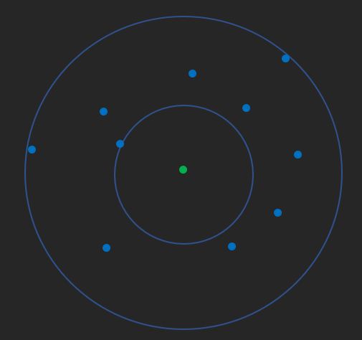
Bridson’s Algorithm
It’s important to know that a lot of the functionality used in Mitchell’s algorithm is brought forwards to this algorithm. Bridson’s algorithm utilises the following methods from Mitchell’s:
float Distance(int[], int[])
int[] FindClosestSample(int [] a) // Slightly modified to only check nearby valid samples
The main difference between Bridson’s and Mitchell’s approach is that Bridson’s algorithm applies an additional rule, which is that the randomly spawned points (the candidates in the previous step) must be spawned within an annulus which extends from radius r to 2r, where r is the minimum distance allowed between valid sample points
Points are created within the circles, by getting random angles and providing the correct distance range

Slide 22
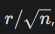
How Bridson's Algorithm Works
Here’s a step-by-step breakdown of Bridson's Algorithm:
Grid Initialization:
The space is divided into a grid of cells. The side length of each cell is where r is the minimum distance between points, and n is the dimensionality of the space (e.g., 2 for 2D).
This grid helps in quickly checking whether new points are too close to existing points and that there is only enough space for 1 point in each.
First Point Placement:
A random point is placed somewhere in the space, and it is added to an "active list."
The grid cell corresponding to this point is marked as occupied.
Notes:
Here you can bring up how randomly placing points and checking radius to see if they overlap, and if so delete and place another is inefficient.

Slide 23
Generating New Points:
While there are points in the active list:
Select a Point: Randomly pick a point from the active list.
Generate Candidates: Around this point, generate new candidate points within an annulus (a ring-shaped area) with a radius between r and 2r.
Check Validity: For each candidate, check if it is at least r away from all existing points by only examining the surrounding grid cells (usually a 3x3 neighborhood around the candidate's cell).
Place Valid Points: If a candidate point is valid (i.e., it is far enough from all other points), add it to the grid, and to the active list.
Remove the Active Point: If no valid points are found after a set number of attempts (typically 30), remove the current point from the active list.
Repeat Until Done:
The process continues until the active list is empty, meaning no more valid points can be generated. At this point, you have a set of points that are uniformly distributed and satisfy the minimum distance criterion.

Slide 24
Lets implement this
Minimum Distance: Ensure that no two points are closer than a specified minimum distance or further than a max distance Active List: Maintain a list of "active" points, from which new points are generated. Grid: Use a grid to efficiently keep track of points and check distances.
Steps:
Initialization:
Choose a starting point randomly in the sampling area and add it to the active list and grid.
Set up an empty grid where each cell has a size of r/ sqrt(2)​. This grid helps in quickly checking if new points are too close to existing ones.
Generating Points:
While there are points in the active list:
Pick a point from the active list.
Generate up to x (usually 30) random points around it within a ring of radius r to 2r.
For each new point:
Check if it is too close to any existing points by examining the surrounding cells in the grid.
If it's not too close, add it to the active list and place it in the corresponding grid cell.
If no valid points are found after x attempts, remove the point from the active list.
Completion:
The process continues until there are no more points in the active list.
The result is a set of points that are evenly spread out.

Slide 25
Summary
We've explored a couple methods for object distribution in video games, each with its advantages and challenges. Implement these methods to see which best suits your project's needs.
There are many other distribution methods, Please read:
Additional distribution methods.docx for more info

Slide 26
Read more?
https://www.redblobgames.com/x/1830-jittered-grid/ Explore alternative methods and play.
https://www.youtube.com/watch?v=7WcmyxyFO7o Sabastian’s
Moodle Site: Additional distribution methods.docx Some more algorithms to play with.

